Slide 1
TAing Effectively During Campus Disruption:
Know Your Options
(A step-by-step guide to available resources)
Teaching Assistant Development Program (TADP)
March 12th, 2020

Slide 2
Objectives
Learn about resources
  To ensure smooth conduct of Winter ’20 finals
  To prepare for Spring ’20 online teaching
  To run your classes/office hours online
  To conduct assessments
Recommendations/suggestions

Slide 3
Winter Finals 2020
If you are proctoring a final exam online (or teaching a class in Spring quarter) you must submit a request for a Zoom Pro account through the service link ASAP.
servicelink.ucr.edu
  To submit a request for a Zoom Pro account
  To submit support ticket
  https://tadp.ucr.edu/resources/teaching-continuity
Further assistance?
  keepteaching.ucr.edu > Strategies +Tools
  All the information necessary to set up final exams on iLearn

Slide 4
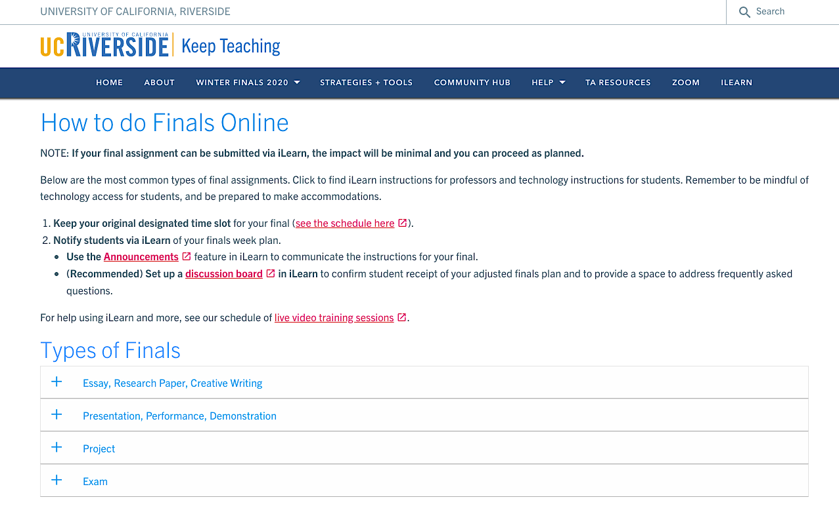
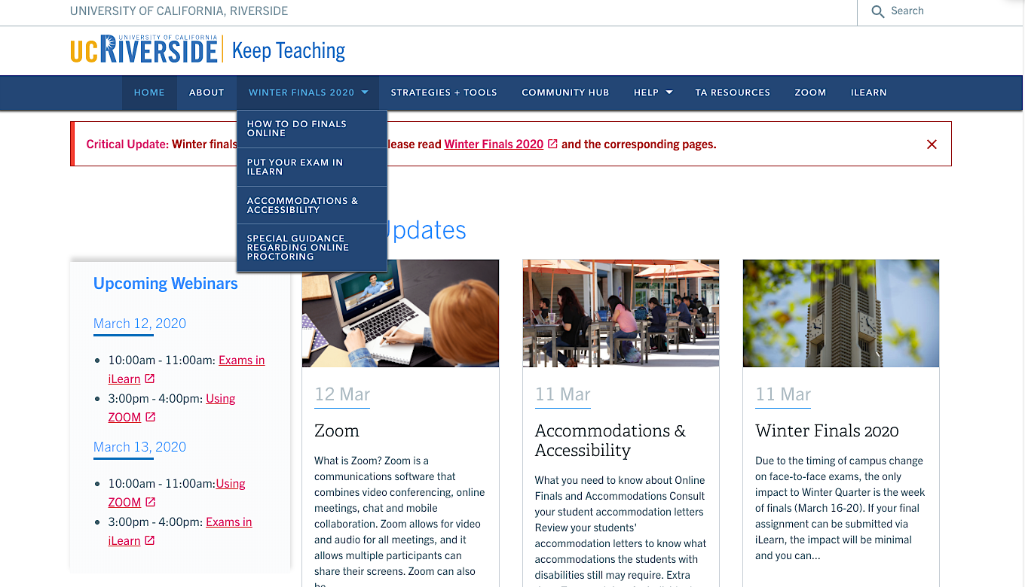
Winter Finals 2020
Guide your course instructor to these resources if needed

Slide 5
Preparation for Spring 2020:
Things to Consider
Class size
Technology access your students will have
Your own experience with technology
Course content
Grading structure of the course and policy
Good news: You already have some of these information!

Slide 6
Options to Facilitate Instruction
There are two options
  Synchronous: instructors and students gather at the same time and interact in “real time” or “near-real time”
  Asynchronous: instructors prepare course materials for students in advance of students’ access. Students may access the course materials at a time of their choosing

Slide 7
Synchronous Teaching
Advantages of Synchronous Teaching
  Immediate personal engagement between students and instructors
  More responsive exchanges between students and instructors
Disadvantages of Synchronous Teaching
  More challenging to schedule shared times for all students and instructors- you have your Spring sessions already scheduled
  Some students may face technical challenges or difficulties if they do not have fast or powerful Wi-Fi networks accessible
Notes:
which may create greater feelings of community and lessen feelings of isolation
which may prevent miscommunication or misunderstanding

Slide 8
Asynchronous Teaching
Advantages of Asynchronous Teaching
  Higher levels of temporal flexibility
  Increased cognitive engagement
Disadvantages of Asynchronous Teaching
  Students may feel less satisfied
  Course material may be misunderstood or have the potential to be misinterpreted without the real-time interaction
  Good news: There are several tools and technologies available to accomplish both
Notes:
which may simultaneously make the learning experiences more accessible to different students and also make an archive of past materials accessible.
since students will have more time to engage with and explore the course material.
without the social interaction between their peers and instructors.

Slide 9
Preparation for Spring ’20 Online Teaching
Talk to your course instructor(s)
Post your syllabus and required materials on iLearn
Make announcements about remote continuity plans on iLearn
Consider what do you normally use your in-class time for
Go over your course assignments for the coming weeks and think about how you will give feedback on students’ progress
If you need to form student groups: Use iLearn (Creating a single group, Creating group sets (for concurrent kinds of groups within a course, i.e., "Research Paper" group set, "Final Project" group set)

Slide 10
Running Your Classes Online
Synchronous Teaching:
  UCR Zoom Resources- short tutorials on scheduling a meeting, online discussion and office hours
  Create Zoom meeting invite links and post them on iLearn (follow your discussion schedule)
    Use screen share and chat features
  Record sessions and post them on iLearn
  Alternative web conferencing tools include Google Hangouts and Microsoft Teams, which is included with Office 365

Slide 11
Running Your Classes Online
Asynchronous Teaching:
  Google Docs, Google Sheets, and Google Slides (collaborative tools available to students)
    can also be used in parallel to Zoom meetings to take questions/comments from the students
  Pre-record lecture videos:
    Zoom (Record a Meeting)
    YouTube (Record & upload a video)
    PowerPoint (Record a slide show with narration and slide timings)
    QuickTime (Record your screen in QuickTime Player on Mac)

Slide 12
Conducting Assessments
iLearn Tests and Quizzes
  Tests, Surveys, and Pools
  Creating Tests and Surveys
  Reading Tests and Survey Results
  Exporting and Importing Tests or Surveys
  Uploading Test Questions from Microsoft Excel
  Foster Communication and Collaboration Among Students
  Assess Student Learning in iLearn
  Edit Tests and Questions
  iLearn Test Availability Exceptions

Slide 13
Finally
Explain — as clearly as you can and in a variety of places — what students can expect about the course in the next few weeks
Be sure to cover what it is that students are responsible for doing, how they can find the things they need to meet those responsibilities
Support:
  bearhelp@ucr.edu (for iLearn troubleshooting)
  tadp@ucr.edu (TADP Coordinator)
  tamentor@ucr.edu (TADP Lead Consultant)

